Slide 1
Lesson 10 - Mouse Events: Mouse Clicked
Mr Mack 2019

Slide 2
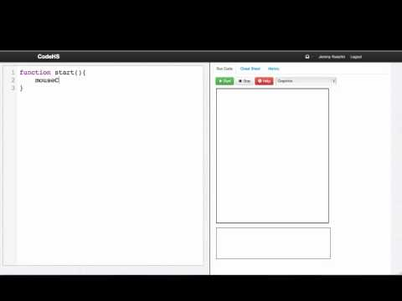

Slide 3
Suppose we’ve written a function drawCircle that we want to call every time the mouse is clicked. How can we do this?
mouseClickMethod(drawCircle(e));
if(mouseClickMethod){
drawCircle();
}
mouseClickMethod(drawCircle);
mouseClickMethod(drawCircle());

Slide 4
What is a callback function?
A function passed to an event handler that is called every time a certain event happens
A function called at the bottom of the start function
A function that is never called
A function called every 20 milliseconds

Slide 5
Example: Click For Circles
This is an example for this lesson. You are encouraged to play around with it, run and change the code, and learn how it works. When you are done, click continue to go to the next problem.

Slide 6
Example: Click For Ghosts
This is an example for this lesson. You are encouraged to play around with it, run and change the code, and learn how it works. When you are done, click continue to go to the next problem.

Slide 7
Exercise 3.10.1: Teleporting Ball
Extend our bouncing ball program. Whenever you click, the ball should teleport to that spot and change to a random color.

Slide 8
Exercise 3.10.2: Pause
Now, instead, extend our bouncing ball program, so you can pause the ball’s movement when you click.
When you click, if the ball is moving, it should pause, or if the ball is already paused, it should start moving again.
Hint: Try using a boolean.

